Slide 1
CS 367 Introduction to Data Structures
Lecture 21

Slide 2
Today’s topics:
Heap Sort
Radix Sort
Bucket Sort
Graphs

Slide 3
Heapify
We’ll view the heap as a tree though it actually maps to array positions (in level order).

Slide 4
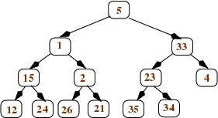
Thus in
value 5 is in the leftmost array position, followed by 1, then 33, and ending with 34.

Slide 5
Heapify works bottom-up, turning sub-trees into mini-heaps.
Start with nodes that are parents of leaves.
We compare each node n with its two children (which are leaves).
We swap n with the larger child, as necessary.

Slide 6
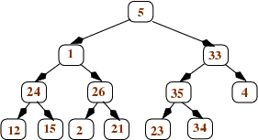
Staring with
we get

Slide 7
We now examine nodes n one level up in the tree.
These nodes have two children, and each is already in heap form.
We again compare a node n with its children and swap the bigger into the root as necessary.
The swapped value is compared with its new children and swap again, until correct heaps are established.

Slide 8
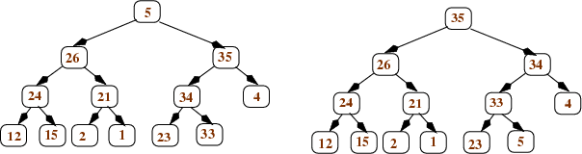
becomes

Slide 9
Then the root is processed:

Slide 10
Cost of Heapify
One half of the nodes are leaves at the bottom the of tree.
They take 1 comparison with their parent to process.
One quarter of the leaves are at height 2 and takes at most two comparisons to process.

Slide 11
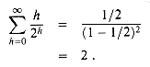
The total time is then
N * (1/2*1 + ¼*2 + 1/8 * 3 + 1/16 * 4 ...)
Now
So heapify is O(N) – linear!

Slide 12
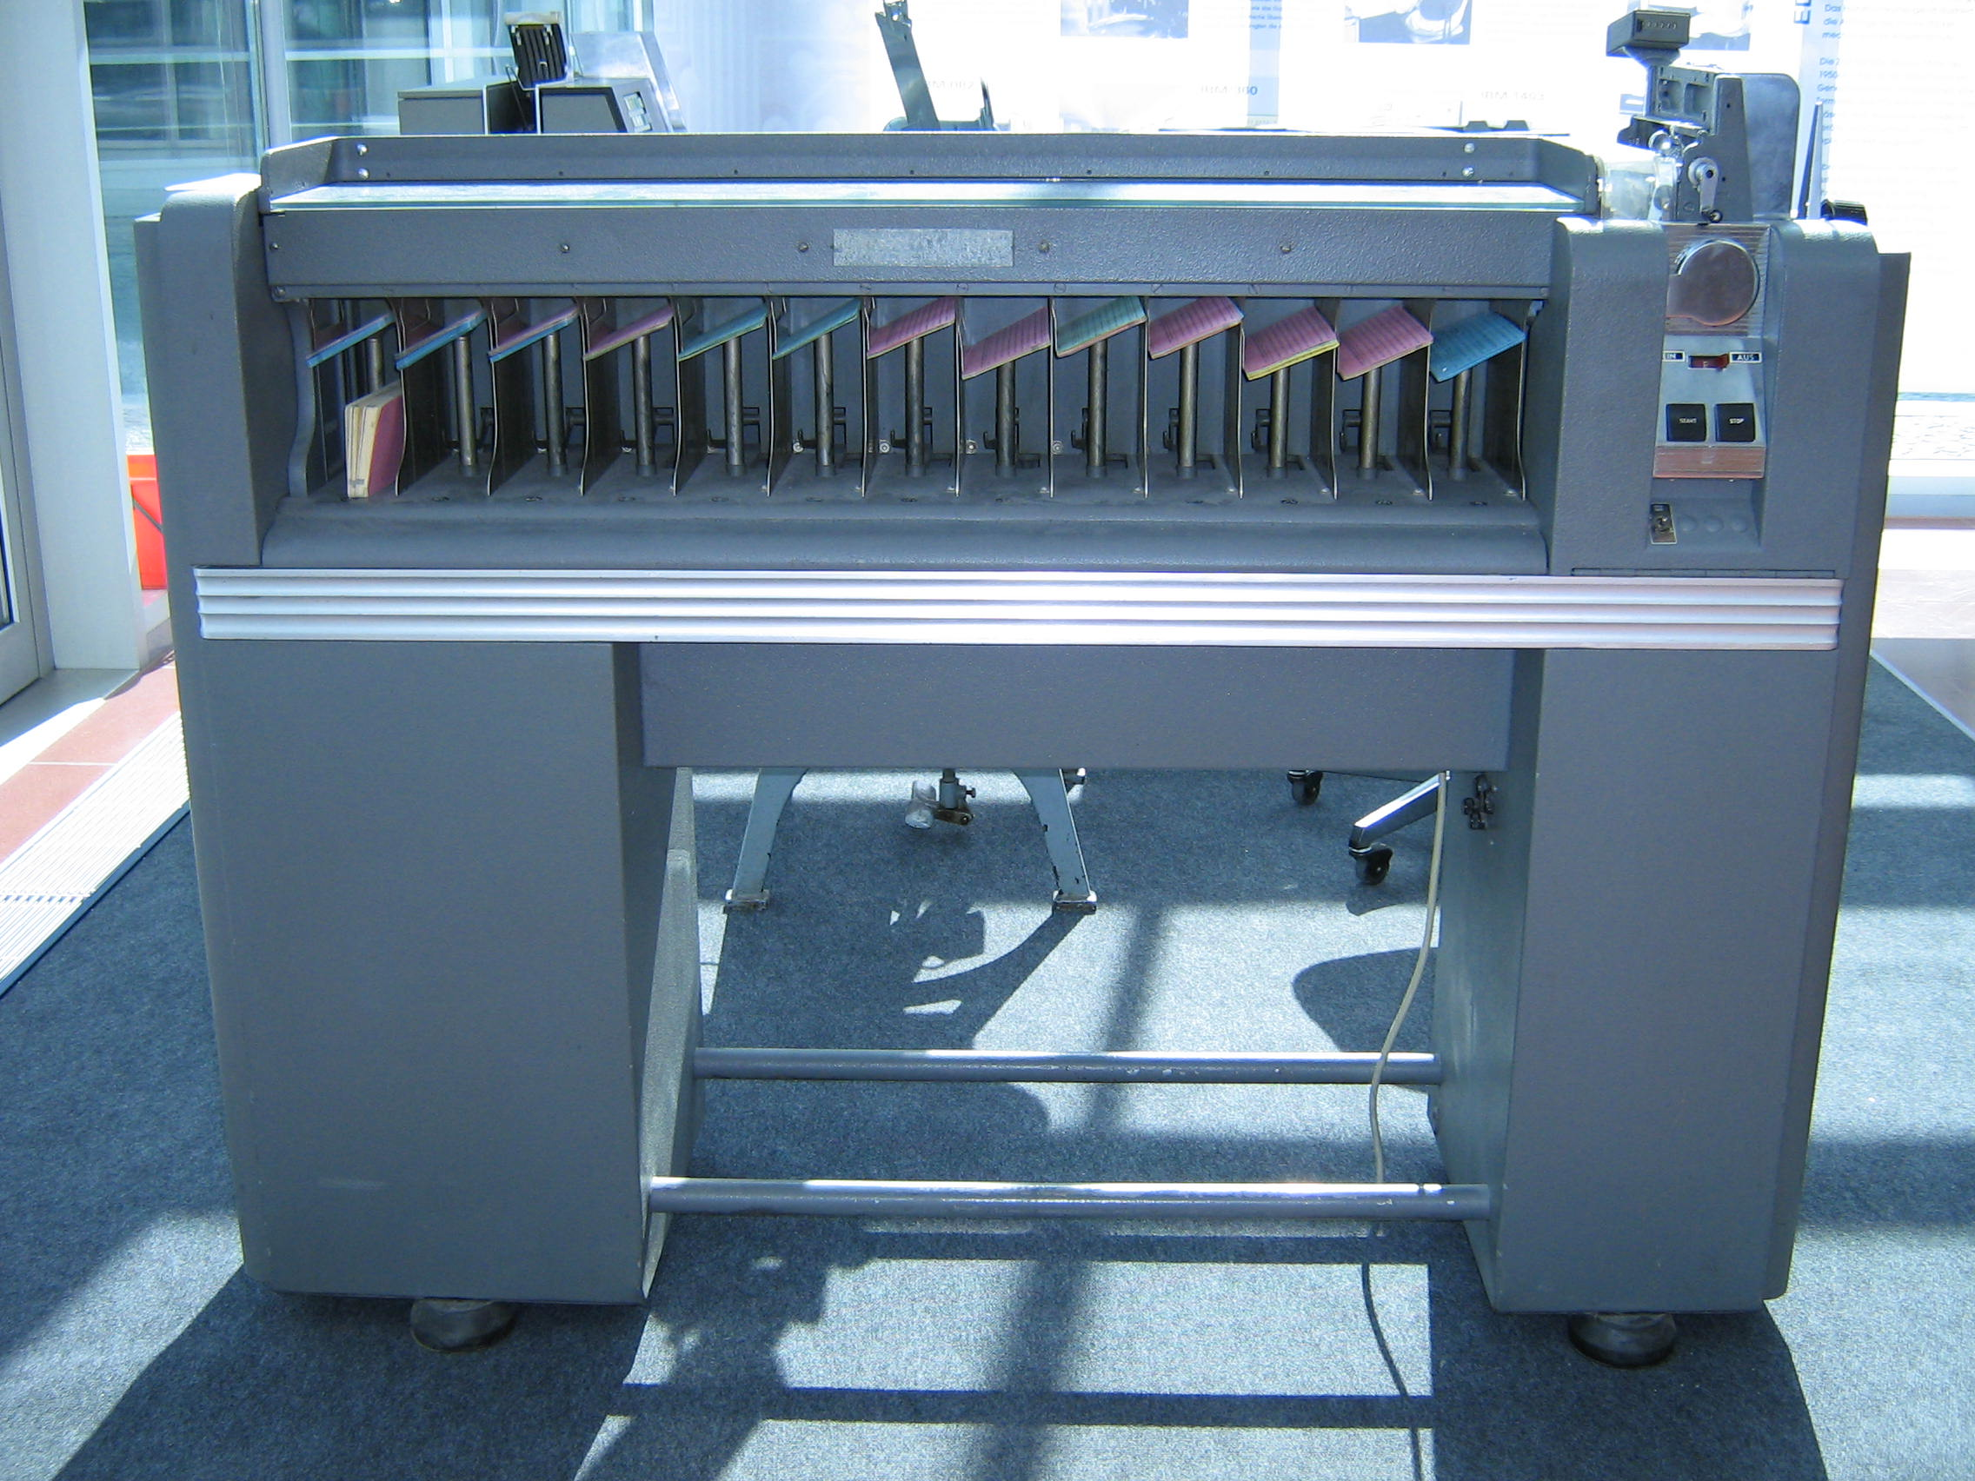
Radix Sort

Slide 13
All the sorts we’ve studied are comparison sorts.
It can be proven that in the worst case a comparison sort must take at least O(N log N).
Sorts that don’t do direct comparisons can be faster.
A Radix Sort is such a sort.

Slide 14
A radix sort works by comparing items character by character (or digit by digit).
If range is the range of individual values
(typically 10 or 26) and
len is the maximum length of items to be sorted, then a radix sort requires
O((N + range) * len) time.

Slide 15
Thus sorting 100 four digit integers takes (100+10)*4 = 440 operations.
Sorting 1000 10 character words (lower-case only) takes (1000 +26) * 10 = 10,260.

Slide 16
Idea behind Radix Sort
We sort items character by character, right to left (least significant to most significant).
After one pass, the items are sorted with respect to the rightmost character.
After 2 passes, items are sorted acording to the last two characters.
After len passes, items are fully sorted.

Slide 17
As items are examined at a particular character position, items are placed in a queue based on the character value.
Then items are dequeued back into the array and the next character position is examined.

Slide 18
Example of Radix Sort
Assume we start with
[132, 355, 104, 327, 111, 285, 391, 543, 123, 535]
Here N = 10, range = 10 and len = 3.
We examine the rightmost digit and place each number in one of 10 queues:

Slide 19
0:
1: 111, 391
2: 132
3: 543, 123
4: 104
5: 355, 285, 535
6:
7: 327
8:
9:

Slide 20
We empty each of the 10 queues into the original array:
[111, 391, 132, 543, 123, 104, 355, 285, 535, 327]
Now we look at the second to last digit,
and refill the 10 queues:

Slide 21
0: 104
1: 111
2: 123, 327
3: 132, 535
4: 543
5: 355
6:
7:
8: 285
9: 391

Slide 22
We again empty each of the 10 queues into the original array:
[104, 111, 123, 327, 132, 535, 543, 355, 285, 391]
We finally look at the last (leftmost) digit,
and refill the 10 queues:

Slide 23
0:
1: 104, 111, 123, 132
2: 285
3: 327, 355, 391
4:
5: 535, 543
6:
7:
8:
9:

Slide 24
When we empty each of the 10 queues into the original array, we have a complete sort:
[104, 111, 123, 132, 285, 327, 355, 391, 535, 543]

Slide 25
Complexity of Radix Sort
Each pass of a radix sort takes O(N) time to fill the queues and O(N + range) time to put partially sorted values back into the input array.
The number of passes is equal to len,
so O((N + range) * len) time is needed.

Slide 26
When is Radix Sort Worthwhile?
The best comparison sorts are O(N log N).
Radix sort is O((N + range) * len) .
Since range is usually much small than N,
radix sort is better if len < log N.
For example, some 56,000,000 people receive Social Security benefits.

Slide 27
Log₂ of 56,000,000 is 25.74.
So a radix sort can be expected to beat an N log N sort by a factor of 25.74/9.
Almost 3 times better!

Slide 28
Bucket Sort
In the case that items are to be sorted into a limited number of positions, a bucket sort is useful.
If an item can be placed into one of k categories, we create k different bags.
We examine each item and place it in the proper bag.
We then visit each bag and collect its contents.

Slide 29
For example, if a company decides to recognize employees on their birthday, we’d create 366 bags.
Then we’d visit each employee record and place the employee’s name in the bag corresponding to the recorded birthday.
If we have N items and k categories,
total time is O(N + k).
Often k is much smaller than N, making the sort effectively linear!

Slide 30
Sorting Summary
Selection Sort:
N passes. On pass k: find the k-th smallest item, put it in its final place
Always O(N²)

Slide 31
Insertion Sort:
N passes, on pass k: insert the k-th item into its proper position relative to the items to its left
worst-case O(N²)
given an already-sorted array: O(N)

Slide 32
Merge Sort:
recursively sort the first N/2 items, recursively sort the last N/2 items, merge (using an auxiliary array)
always O(N log N)

Slide 33
Quick Sort:
choose a pivot value partition the array:
left part has items <= pivot
right part has items >= pivot recursively sort the left part recursively sort the right part
worst-case O(N²)
expected O(N log N)

Slide 34
Heap Sort:
use heapify to convert the unsorted array into a heap, then do N removeMax operations. Each operation frees one more space at the end of the array; put the returned max value into that space.
always O(N log N)

Slide 35
Radix Sort:
make len passes through the N sequences to be sorted, right-to-left on each pass, put the values into the queue in position p of the auxiliary array, where p is the value of the current "digit" then put the values back from the auxiliary array into the original array
no comparisons of values are done (i.e., radix sort is not a comparison sort).
always O(N + range) * len)

Slide 36
Bucket Sort:
Map each item into one of k buckets
no comparisons of values are done (not a comparison sort).
always O(N + k)

Slide 37
Graphs
A generalization of trees
Graphs have nodes and edges
(Sometimes called vertices and arcs)
Nodes can have any number of incoming edges.
Every tree is a graph, but not all graphs are trees

Slide 38
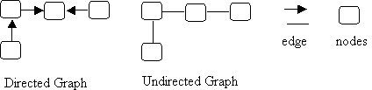
Directed and Undirected Graphs
Edges may have a direction (be an arrow)
or may be undirected (just a line)

Slide 39
In a directed graph you must follow the direction of the arrow
In an undirected graph you may go in either direction
Directed graphs may reach a “dead end”

Slide 40
Graph Terminology
The two nodes are adjacent (they are neighbors).
Node 2 is a predecessor of node 1.
Node 1 is a successor of node 2.
The source of the edge is node 2 and the target of the edge is node 1.

Slide 41
Nodes 1 and 3 are adjacent (they are neighbors).

Slide 42
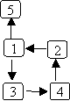
In this graph, there is a path from node 2 to node 5: 2→1→5.
There is a path from node 1 to node 2: 1→3→4→2.
There is also a path from node 1 back to itself: 1→3→4→2→1.
The first two paths are acyclic paths: no node is repeated; the last path is a cyclic path because node 1 occurs twice.

Slide 43
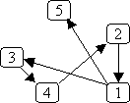
Graph layout is somewhat arbitrary;
the following two graphs are equivalent.
Why?
Which is “cleaner”?

Slide 44
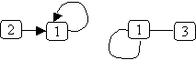
An edge may connect a node to itself:

Slide 45
Special Kinds of Graphs
A directed graph that has no cyclic paths (that contains no cycles) is called a DAG (a Directed Acyclic Graph).

Slide 46
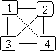
An undirected graph that has an edge between every pair of nodes is called a complete graph. Here's an example:
A directed graph can also be a complete graph; in that case, there must be an edge from every node to every other node.

Slide 47
A graph that has values associated with its edges is called a weighted graph. The graph can be either directed or undirected. The weights can represent things like:
The cost of traversing the edge.
The length of the edge.
The time needed to traverse the edge.

Slide 48
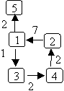
A weighted graph:

Slide 49
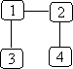
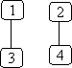
An undirected graph is connected if there is a path from every node to every other node.
For example:
(connected) (not connected)

Slide 50
A directed graph is strongly connected if there is a path from every node to every other node. A directed graph is weakly connected if, treating all edges as being undirected, there is a path from every node to every other node.

Slide 51
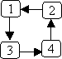
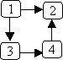
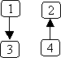
For example:
Strongly Weakly connected Neither weakly
connected Not strongly connected nor strongly connected

Slide 52
Uses for Graphs
Usually, nodes are objects and edges relationships.
For example:
Flights between cities. The nodes represent the cities and edge j → k means there is a flight from city j to city k. This graph could be weighted, using the weights to represent distance, flight time, or cost.

Slide 53
Interdependent tasks to be done. Nodes represent the tasks and an edge j → k means task j must be completed before task k. For example, we can use a graph to represent courses to be taken, with edges representing prerequisites:

Slide 54
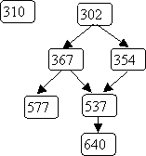

Slide 55
Flow charts (also known as control-flow graphs). Nodes represent statements and conditions in a program and the edges represent potential flow of control.

Slide 56
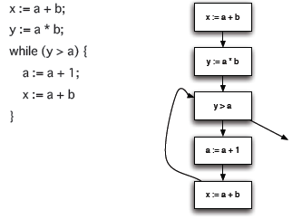

Slide 57
State transition diagrams. Nodes represent states and edges represent legal moves from state to state. For example, we could use a graph to represent legal moves in a game of tic-tac-toe.
Here's a small part of that graph:

Slide 58
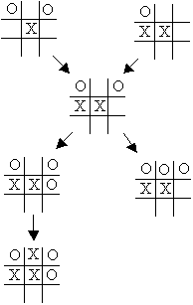

Slide 59
Graphs can be used to answer a variety of interesting questions:
What is the cheapest way to fly from Madison to Kauai?
What are the prerequisites to CS 367?
Can variable v be used before it is initialized?
Can I force a win in tic-tac-toe given my current position?

Slide 60
Representing Graphs
Trees are represented using a number of Treenodes, with a Tree class that points to the root node of the tree.
Some graphs also have a special source or “start node.” In such cases we use a number of Graphnodes, along with a Graph class that points to the start node.

Slide 61
Other graphs have no special start node, so a graph is simply a list (or set or array) of Graphnodes.
Of course each Graphnode will contain data (parameterized as type T) and a list of successor nodes.

Slide 62
class Graphnode<T> {
// *** fields ***
private T data;
private List<Graphnode<T>> sucessors =
new ArrayList<Graphnode<T>>();
// *** methods ***
...
}

Slide 63
public class Graph<T> {
// *** fields ***
private List<Graphnode<T>> nodes = new ArrayList<Graphnode<T>>;
// *** methods ***
...
}

Slide 64
What about Weighted Graphs?
We need to store a weight along with the edges.
We can store a list of weight, successor pairs or store a second list of edge weights.

Slide 65
Depth-first Search
We visit nodes in the graph by following edges, with the rule that we visit “new nodes” whenever possible.
Of course, not all nodes are necessarily reachable from a given start node.

Slide 66
Depth-first searches allow us to answer many interesting graph-related questions:
• Is it connected?
Is there a path from node j to node k?
Does it contain a cycle?
What nodes are reachable from node j?
Can the nodes be ordered so that for every node j, j comes before all of its successors in the ordering?

Slide 67
Basic Idea in Depth-first Search
We keep an array of booleans called visited, one for each node.
The algorithm is simply:
Start at node n.
Mark n as visited.
Recursively do a depth-first search from each of n’s unvisited successors.

Slide 68
public static void dfs (Graphnode<T> n) {
n.setVisited(true);
for (Graphnode<T> m : n.getSuccessors()) {
if (! m.getVisited()) {
dfs(m);
}
}
}

Slide 69
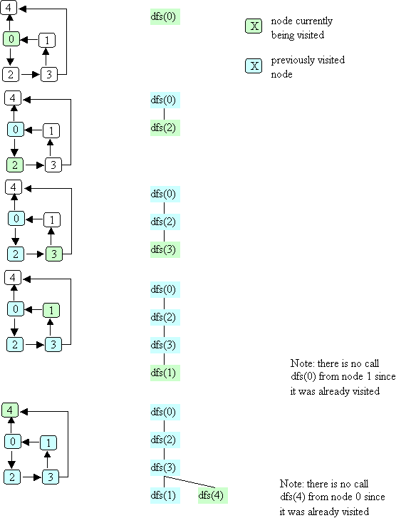
Example of Depth-first Search

Slide 74
Complexity of Depth-first Search
We have a call for each reachable node and we examine each edge from reachable nodes.
In the worst case, we may visit all nodes and edges.
Complexity is O(N + E)

Slide 75
Uses for Depth-first Search
Is there a path from node j to node k?
What nodes are reachable from node j?
Is a graph connected?
Does a graph contain a cycle?
Can the nodes be ordered so that for every node j, j comes before all of its successors in the ordering?

Slide 76
Path Testing
We want to know if a path from node j to node k exists.
But our DFS algorithm already tells us this!
If such a path exists, then a DFS, starting at j, will mark k as visited!

Slide 77
boolean pathExists(Graphnode<T> j, Graphnode<T> k){
this.setVisited(false);
dfs(j);
return k.getVisited();
}

Slide 78
Reachable Nodes
Here we can use our path test.
We try each possible node and ask if a path from the start node exists.

Slide 79
ArrayList<Graphnode<T>> reachable(Graphnode<T> j){
ArrayList<Graphnode<T>> in =
new ArrayList<Graphnode<T>>();
for(Graphnode<T> k:
this.getNodes()){
if (pathExists(j,k)
in.add(k);
return in;
}

Slide 80
Connected Graph Testing
We can check where is graph is connected (or strongly connected) by simply checking if a path from each pair of nodes exists.

Slide 81
boolean isConnected(){
for(Graphnode<T> j:
this.getNodes()){
for(Graphnode<T> k:
this.getNodes()){
if (! pathExists(j,k)
return false;
} }
return true;
}

Slide 82
Cycle Detection
Many graph algorithms, like reachability, assume a path of length 0 always exists from a node to itself.
Thus node n is always reachable from itself by doing nothing.
But a path of length 1 or more may be problematic. For example, a course may not be its own prerequisite!

Slide 83
Our algorithm for cycle detection will consider two cases:
A node n is its own immediate successor. This is possible, but also easy to test for (look at edges from n).
A path of length 2 or more is also possible. Here we simple look at all immediate successors of n. From each we ask if a path from that node to n exists.

Slide 84
boolean hasCycle(Graphnode<T> j){
if (j.getSucessors().contains(j))
return true;
for (Graphnode<T> k:
j.getsuccessors()){
if (pathExists(k,j)
return true; }
return false;
}

Slide 85
We may also want to know if a graph has a cycle anywhere. This is easy too – we just check each node in turn for a cycle starting at that node.

Slide 86
boolean hasCycle(){
for (Graphnode<T> k:
this.getnodes()){
if (hasCycle(k))
return true;
}
return false;
}

Slide 87
Topological Ordering
Graphs can be used to define ordering relations among nodes. That is j → k means node j must be visited before node k is.

Slide 88
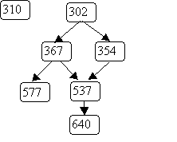
An example of ordering relations represented by graphs is a course prerequisite chain. For example:

Slide 89
A student may register for a course like 640 only after 537, 367, 354 and 302 have been taken. However 310 may be taken before or after 640, since no ordering between them is indicated.

Slide 90
A topological ordering of nodes in a graph is a sequencing of nodes that respects the graph’s ordering relations.
That is, if the graph contains j → k,
then j must always be listed before k.
We can use a variant of depth-first search to do a topological ordering.
We require that the graph we will order has no cycles. Cycles make a valid numbering impossible.
Why?

Slide 91
Recall that we already know for to test a graph for cycles.
We will identify one or more “start nodes” in a graph. A start node is simply a node that has no incoming edges.
We start at such nodes because starting elsewhere makes them unreachable.
Each node has a boolean flag isDone, initially false. When a node’s isDone flag becomes true, it is assigned an ordering number and needs no further processing.

Slide 92
As in depth first search, we process a node after all its children have been processed. Thus leaf nodes get a number, then their parents, etc.
We assign numbers last to first so that the order number assigned to a leaf is larger than that assigned to its parent.

Slide 93
The method we will use is
int topOrder(Graphnode<T> n, int num)
The parameter num is the last (highest) number to be assigned. The method returns the highest unused order number (the graph may not be connected, so numbering may need to be done in pieces).

Slide 94
int topOrder(Graphnode<T> n, int num) {
for (Graphnode<T> m : n.getSuccessors()) {
if (! m.isDone) {
num = topOrder(m, num);
}
}
// here when n has no more successors
n.isDone = true;
n.setOrder(num);
return num - 1;
}

Slide 95
Example of topOrder
We order the course prerequisite graph
We’ll start at node 302 with num = 7.

Slide 96
Breadth-first Search
An alternative to depth-first choice is breadth-first search.
From a starting node all nodes at distance one are visited, then nodes at distance 2, etc.
This sort of search is used to find the shortest path between two nodes.

Slide 97
We’ve already seen the tree-oriented version of breadth-first search – level order traversal.
As in level-order traversal, we use a queue to remember nodes waiting to be fully processed.
We also use a “visited” flag to remember nodes already processed (and queued).

Slide 98
public void bfs(Graphnode<T> n) {
Queue<Graphnode> queue =
new Queue<Graphnode>();
n.setVisited(true);
queue.enqueue( n );
while (!queue.isEmpty())) {
Graphnode<T> current = queue.dequeue();
for (Graphnode<T> k : current.getSuccessors()) {
if (! k.getVisited()){
k.setVisited(true);
queue.enqueue(k);
} // end if k not visited
} // end for every successor k
} // end while queue not empty
}

Slide 99
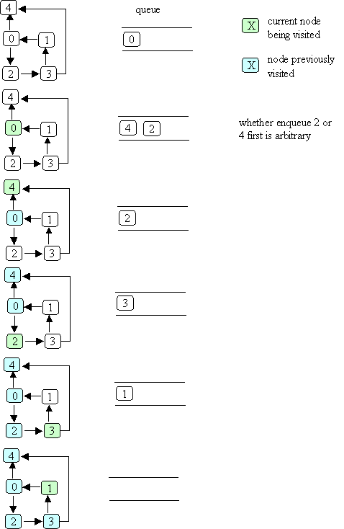
Example of Breadth-first Search

Slide 101
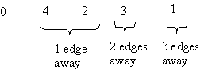
Starting at node 0, the visit order is

Slide 102
Shortest Path
We can use bfs to find the shortest distance to each reachable node:
add a distance field to each node
when bfs is called with node n, set n's distance to zero
when a node k is about to be enqueued, set k's distance to the distance of the current node (the one that was just dequeued) + 1

Slide 103
Shortest Weighted Path
The shortest path does not always give us the best result. Consider a highway map, listing cities and distances:

Slide 104
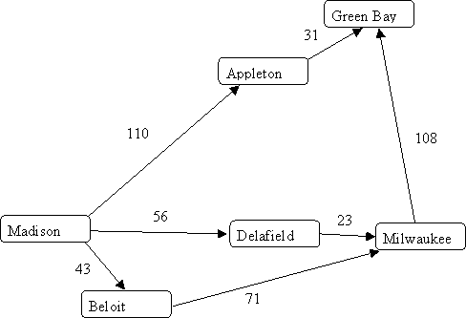

Slide 105
Shortest path tells us the best route from Madison to Milwaukee is through Beloit, since it takes just “two steps.”
But looking at distances tells us the route through Delafield is better.
What we need is a shortest weighted path algorithm.
Dijkstra’s algorithm lets us compute shortest weighted paths efficiently.

Slide 106
Dijkstra’s Algorithm
Dijkstra’s algorithm uses an “explorer” approach, in which we visit nodes along various paths, always recording the shortest (or fastest, or cheapest) distance.
We start at a source node. The distance from source s to itself is trivially 0.

Slide 107
We then look at nodes one step away from the source. Tentative distances are recorded. The smallest distance gives us the shortest path from s to one node.
Why?
This node is marked as “finished.”
We next look the nearest node not marked as finished. Its successors are explored. The node marked with the shortest distance is marked as finished.
Then the unfinished node with the shortest distance is explored.

Slide 108
The process continues until all nodes are marked as finished.
Here is an outline of Dijkstra’s Algorithm.
We start with:
A graph, G, with edges E of the form
(v1, v2) and vertices (nodes) V, and a source vertex, s.

Slide 109
The data structures we use are:
dist : array of distances from the source to each vertex
prev : array of pointers to preceding vertices
i : loop index
F : list of finished vertices
U : list or heap unfinished vertices

Slide 110
Initialization:
F = Empty list
U = All vertices (nodes)
for (i = 0 ; i < U.size(); i++) {
dist[i] = INFINITY;
prev[i] = NULL;
}
dist[s] = 0; // Starting node

Slide 111
while (U.size() > 0) {
pick the vertex, v, in U with the
shortest path to s;
add v to F; remove v from U;
for each edge of v, (v1, v2) {
if (dist[v1] + length(v1, v2)
< dist[v2]) {
dist[v2] =
dist[v1] + length(v1, v2);
prev[v2] = v1;
}
}
}

Slide 112
Example of Dijkstra’s Algorithm

Slide 113
Complexityof Dijkstra’s Algorithm
The complexity is measured in terms of edges (E) and vertices (nodes) N.
If list U is implemented as an unordered list, execution time is O(N²)
Why?
As each node is processed, the U list must be searched for the cheapest unfinished node.

Slide 114
But the U list may also be implemented as a priority queue (using a heap).
Then getting the cheapest unfinished node is only log N.
But each time an edge is used to update the best known distance, the priority queue may need to be restructured into heap form.
This leads to O(E log N), which is usually better than O(N²).

Slide 115
Traveling Salesman Problem
Given n cities we wish the shortest (or fastest, or cheapest) path that visits each city and returns to the starting point.

Slide 116
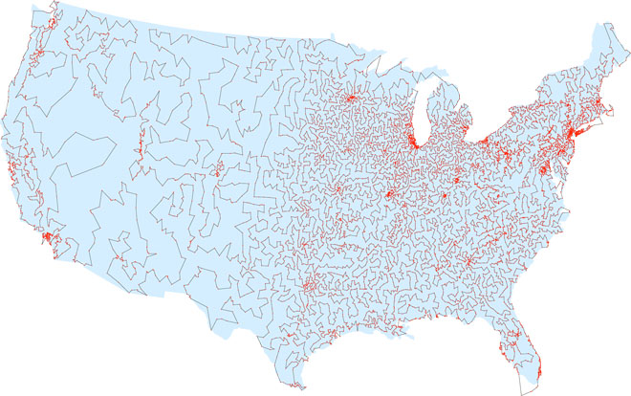

Slide 117
The obvious approach is to try all possible paths. But this is exponential!
Perhap a generalization of Dijkstra’s algorithm?
No – theoretical computer science tells us the best we can do most likely must be exponential.

Slide 118
Approximation Algorithms
What if we accept something close to optimal?
Christofis’s algorithm guarantees a solution no worst than 50% above optimal. It is O(N³).
Heuristics often improve Christofis’s bound. For example, try to swap pairs of adjacent cities.

Slide 119
CS 577 Introduction to Algorithms
Basic paradigms for the design and analysis of efficient algorithms: greed, divide-and-conquer, dynamic programming, reductions, and the use of randomness. Computational intractability including typical NP-complete problems and ways to deal with them.

Slide 120
Epic Picnic
When: Tuesday, April 17th, 5:45-7:30pm
Where: Epic Campus, Verona – Voyager Hall – MIR Commons
Transportation: Shuttle service between UW and Epic is provided. If you’re driving, we’ll send directions. Dress: Casual

Slide 121
No Office Hours Wed and Thurs
Today’s topics:
Graphs
Depth-First Search
Graph Algorithms

